Slide 1
Session 1 :
Computational
Thinking
INTRO TO PYTHON AND BIOINFORMATICS
Presented by : VAISHNAVI VENKAT (3rd yr AIE)
5th August 2024

Slide 2
What do you think when you hear the term
CT ?

Slide 3
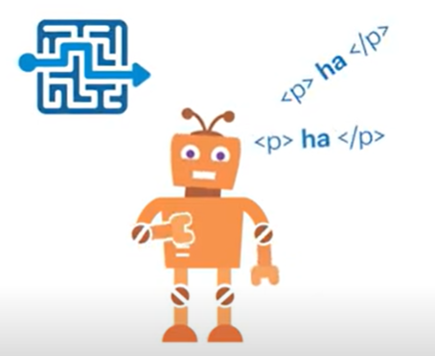
WHAT IS CT ?
A combination of skills which involves LOGICAL DECISIONS & PROBLEM SOLVING
CT is necessary for a computer/machine to carry out its solution
And finally it is most important for
CS people

Slide 4
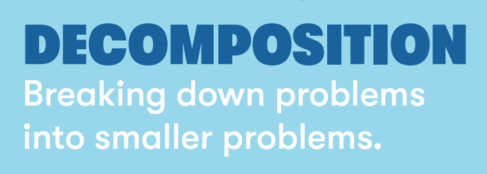
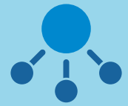
4 Elements of CT

Slide 5
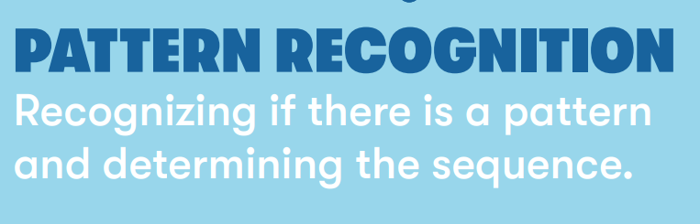

4 Elements of CT

Slide 6
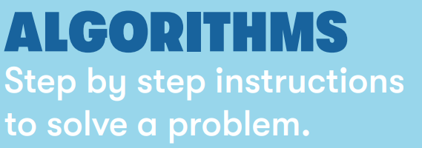

4 Elements of CT

Slide 7
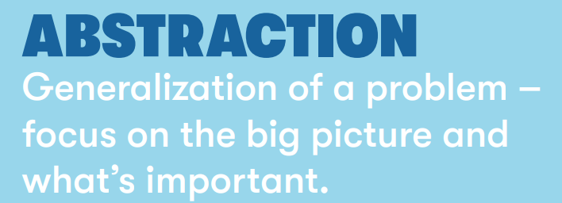

4 Elements of CT

Slide 8

TASK

Slide 9
INSTRUCTIONS
THE ENTIRE CLASS IS DIVIDED INTO 4 GROUPS
EACH TEAM SHOULD WRITE A STEP WISE ALGO AND ONE PERSON FROM THE TEAM GETS 3 CHANCES TO IDENTIFY THE OBJECT.
TEAM WHO TAKES THE LEAST CHANCE IS THE WINNER.

Slide 10
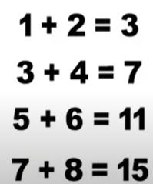
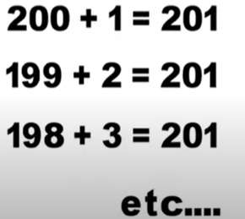
CT ALGO PSEUDOCODE
FIND THE SUM OF NUMBERS FROM 1 TO 200
Decomposition:

Slide 11
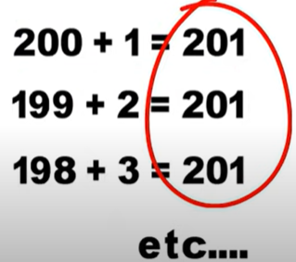
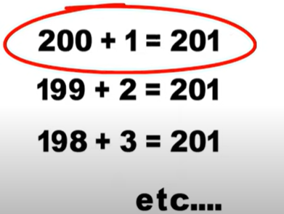

Pattern Recognition:

Slide 12

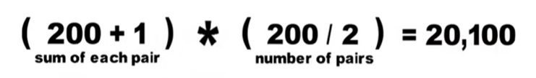
Abstraction:

Slide 13
Algorithm Design:
sum = 0
for i in range(1, 201):
sum = sum + i
print sum
- Initialize the sum variable
sum = 0
- Loop through numbers from 1 to 200
for i in range(1, 201):
sum += i
- Print the result
print("The sum of numbers from 1 to 200 is:", sum)

Slide 14
2) CHECKING IF THE NUMBER IS PRIME
Approach
Decomposition: Check divisibility of the number by any number less than itself.
Pattern Recognition: A prime number is only divisible by 1 and itself.
Abstraction: Focus on divisibility.
Algorithm Design: Write the steps to check divisibility.
Algorithm
If the number is less than or equal to 1, it is not prime.
Loop from 2 to the number.
If the number is divisible by any of these, it is not prime.
If no divisors are found, the number is prime.

Slide 15
PSEUDOCODE
if number <= 1:
print "Not prime"
else:
for i in range(2, number):
if number % i == 0:
print "Not prime"
break
else:
print "Prime"

Slide 16
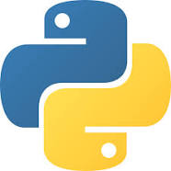
INTRO TO PYTHON
High level language
Easily interpretable and simple to code with

Slide 17
POPULARITY OF PYTHON
Readability: Python's syntax is clear and easy to understand, which reduces the cost of program maintenance.
Versatility: Python can be used for web development, data analysis, artificial intelligence, scientific computing, and more.
Community and Libraries: Python has a vast ecosystem of libraries and frameworks (e.g., NumPy, Pandas, TensorFlow, Django), which speeds up development and reduces the need to write code from scratch.
Cross-Platform: Python runs on various platforms (Windows, macOS, Linux), making it highly portable.

Slide 18
APPLICATION OF PYTHON
Applications in Various Fields
Web Development: Frameworks like Django and Flask.
Data Analysis: Libraries like Pandas and NumPy.
Machine Learning and AI: Libraries like TensorFlow and scikit-learn.
Scientific Computing: Tools like SciPy.
Automation: Scripting and task automation.

Slide 19
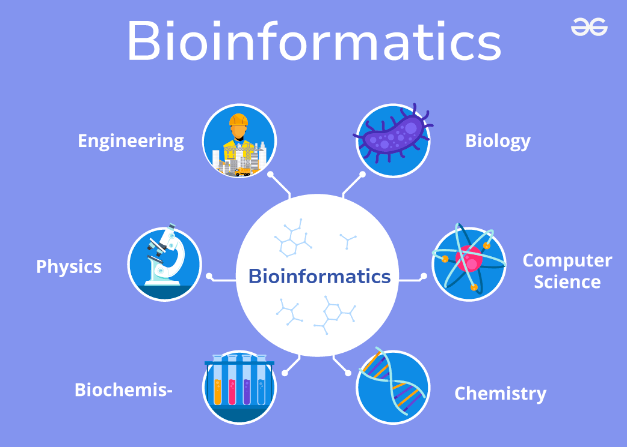
BIOINFORMATICS
Bioinformatics is an interdisciplinary field that combines biology, computer science, and data analysis to understand and interpret biological data

Slide 20
Intersection of Biology, Computer Science, and Data Analysis
Biology: Provides the raw data (e.g., DNA sequences, protein structures).
Computer Science: Provides the algorithms and computational tools to process and analyze the data.
Data Analysis: Applies statistical and machine learning techniques to extract meaningful insights from the data.

Slide 21
Examples of Bioinformatics Applications
Genomics: Sequencing and analyzing genomes to understand genetic variation and disease.
Proteomics: Studying the structure and function of proteins.
Drug Discovery: Identifying potential drug targets and predicting drug interactions.
Evolutionary Biology: Understanding the evolutionary relationships between species.
Personalized Medicine: Tailoring medical treatment to individual genetic profiles.

Slide 22
The End

Slide 23
UPCOMING SESSIONS
Computational Thinking
Setting up Jupyter Notebook
Python basic syntax and data types
Conditional statement and loops
Lists,tuples,sets,arrays,dictionaries
Calling functions,return functions ,lambda functions
2 sessions of problem solving in python
What is bioinformatics ?
Representing DNA structures using excel
Reading and Writing DNA Sequences
Intro to Machine Learning

